Slide 1
2022 Annual RFQ
Kickoff Meeting

Slide 2
Why an annual RFq?
Consolidate efforts for annual Capital Improvements Programs (PWT, Water Utilities, and Parks)
Provide a fair and transparent process for consultant selection

Slide 3
Schedule and submittal
RFQ are due NO LATER THAN 4:30 PM, December 10, 2021
Public Works & Transportation Amy Cannon, P.E. City Hall – 2nd floor PWT Desk 101 W Abram St Questions to: Amy Powell amy.powell@arlingtontx.gov | Water Utilities Brad Franklin, P.E. City Hall – 2nd floor Water Desk 101 W Abram St Questions to: Ashley Brown ashley.brown@arlingtontx.gov | Parks Scott Fairman Parks Building Front Desk 717 W Main St Questions to: Chris Hayden chris.hayden@arlingtontx.gov
Notes:
We will stamp it with the date and time it was received.

Slide 4
Mandatory Items
Cover letter
Consultant Contact Sheet
MWBE Forms and Certificates
Not following directions can lead to immediate disqualification
Notes:
If RFQ requirements are not met, it does not speak well to your firm’s ability to comply with the DCM or to QAQC your own submittals

Slide 5
Project Categories
Each Department will have individual project categories.
Number of projects is subject to change based upon City budget approved in March each year.
Selection is not a guarantee of a contract.

Slide 6
Project Categories
PUBLIC WORKS &
TRANSPORTATION
Roadway (collector/arterial)
Residential Rebuild
Sidewalk
Intersection Improvements
Traffic Engineering Design Services
Traffic Impact Analysis Review
Bridge Repairs
Drainage Design
Drainage Analysis
Erosion Design
Drainage Technical Review
Dredging and Permits
Survey Services

Slide 7
Project Categories
PARKS
Park Improvements & Renovations
Roadway, Parking & Drainage
Linear Park Trail Development

Slide 8
Project Categories
WATER UTILITIES
Pipeline Design
Pipeline Stream Crossing Design and Geomorphological Services
Surveying Services
Distribution System Water Quality Analysis
Sanitary Sewer Flow Monitoring
Water and Sanitary Sewer Utility Asset Inventory and Financial Valuation
Water Treatment Multi-Discipline Engineering Support
Water Treatment Instrumentation, Control, and SCADA
Water Tank Inspection and Evaluation Services

Slide 9
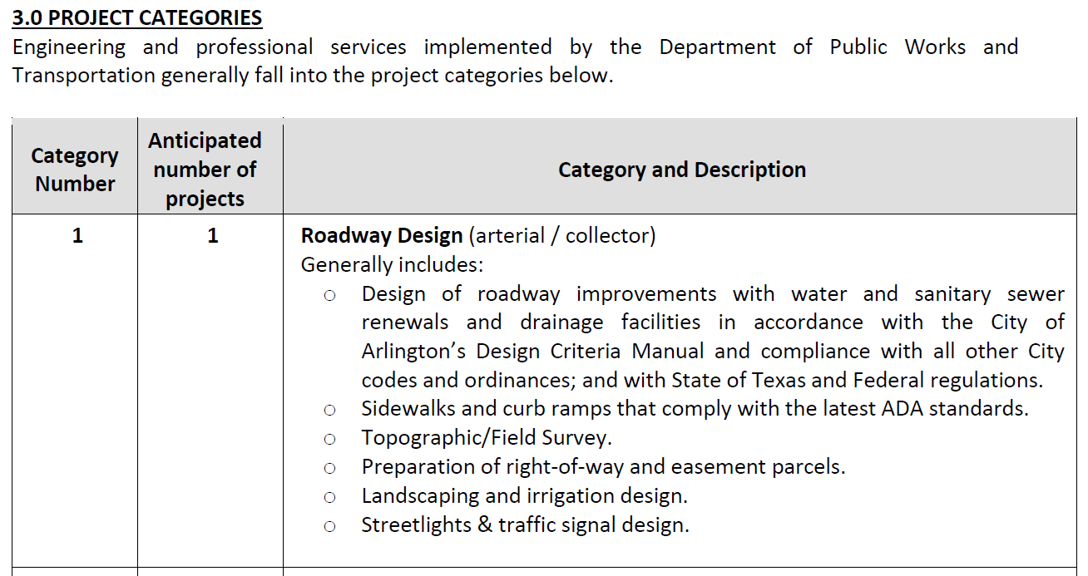

Slide 10
Team organization
Include your organization chart for each specific category.
Describe qualifications, education, and relevant certifications of all key team members.
The City of Arlington expects the team listed in the proposal to perform the work on the project.
Identify sub-consultants.
Identify your QAQC person.
Notes:
-team organization and project experience are where the bulk of the points are earned
-For most projects, key team members should include more than the PM
-The City of Arlington expects the team listed in the proposal to perform the work on the project
Reach out to sub-consultants and form those relationships prior to submitting, include their experience if they are key team members
We will require that the QAQC person in your RFQ is the person actually checking work before it comes to the City

Slide 11
Project experience
Each example should be up to one page in length
Opportunity to set yourself apart
Experience should be relevant to project category
Be clear about roles of key personnel
Submit completed projects from past 5 years
Submit plan sheet if example resulted in construction plans
Notes:
-Try not to get into weeds on this slide, save that for tips later on
-this is your opportunity to set yourself apart, make sure you talk about experience relevant to this category, for example, if a roadway project includes a big traffic piece then talk mainly about the traffic component in your traffic submittal and mainly about the roadway in the roadway submittal.
-describe the challenges and opportunities on the project, if its older, describe your role during construction
- We understand this is a huge undertaking, but its hard to judge submittal against submittal when they all say “I design XX LF of 4 lane roadway with drainage, sidewalks, and 5 traffic lights. It was great”
-Its ok to submit work done by key personnel at another firm, or work completed as a sub, but make sure what happened is clear and that there isn’t overlap between what you are saying you did vs what the other firms that worked on the project may be saying. If there is confusion as to who did what when multiple firms use the same project then we are likely to question what everyone is submitting

Slide 12
Evaluation and Selection
Evaluation committees include representation from multiple departments
Submittals are scored based on pre-determined criteria
Evaluations will happen in late 2021 and selections will be announced in early 2022
2022 Consultants list will be posted on Ionwave
Questions during this process are welcome, but lobbying efforts will result in immediate disqualification.

Slide 13
Minority/Women Owned Business Enterprise
The City of Arlington has an overall MWBE goal of 30% project participation; Prime participation can be included and counted towards the goal efforts.
The MWBE Utilization Plan and Vendor Certifications should be included with the proposal and identify all subconsultants participating on the project team.
After Vendor Selection, there will be a negotiation meeting with the User Department, Office of Business Diversity and selected proposer to finalize the MWBE Utilization Plan and submit the subconsultants Letters of Intent and any Good Faith Efforts (if applicable).
The successful proposer will report monthly on Prime & Subconsultant payments though the Diversity Software Program – B2G.

Slide 14
Common PITFALLS
Grammar and spelling errors are noted will be scored against the submittal.
Not following instructions.
Not being clear about team member roles.
Not being clear about subconsultants roles.
Not providing information about MWBE subconsultants.
Stating that MWBE subconsultants will be selected later.
Submitting the same exact team for each category.
Excessive marketing material, not being concise.
Notes:
-even if you are a small firm, you will most likely have different subs based on the different categories
-no “MWBE sub goes here” placeholders. Don’t identify an internal team member AND a MWBE or local sub for the same exact item in your org chart. Identify your subs and their role on the project team.
- would you submit a traffic control or pavement marking sheet to show experience in the Roadway Design category? No.
- a team of 16 for the sidewalk category?
submit only for categories that are relevant to your past work
Make sure your plan sheet is signed and sealed by someone on your team. Submit a plan sheet for every example that resulted in construction plans. Don’t submit a plan sheet with a bunch of revisions. It looks like you did a poor job in design because we don’t have the history on why there were revisions.

Slide 15
Common PITFALLS
Not submitting 3 plan sheets for each category.
Submitting plan sheets sealed by someone not listed on the team.
Submitting only cover sheets.
Copy and pasting entire teams into other categories and not adjusting it for the category.
Submitting irrelevant plan sheets, not sealing plan sheets, submitting plan sheet with lots of revisions.
Past performance is a major consideration.
Notes:
-even if you are a small firm, you will most likely have different subs based on the different categories
-no “MWBE sub goes here” placeholders. Don’t identify an internal team member AND a MWBE or local sub for the same exact item in your org chart. Identify your subs and their role on the project team.
- would you submit a traffic control or pavement marking sheet to show experience in the Roadway Design category? No.
- a team of 16 for the sidewalk category?
submit only for categories that are relevant to your past work
Make sure your plan sheet is signed and sealed by someone on your team. Submit a plan sheet for every example that resulted in construction plans. Don’t submit a plan sheet with a bunch of revisions. It looks like you did a poor job in design because we don’t have the history on why there were revisions.

Slide 16
What sets you apart
Effort to match your proposed team organization and experience to the specific project category.
Tailoring your examples to the types of projects identified in the CIP.
Giving value added examples of difficult situations or innovative approaches, through proposed team structure, application of technology, creative solutions, etc.
Showing your team has the specialized experience needed for category.
Previous work history.
Notes:
- if you put thought into each category you submit for, it shows
- We call references, we talk to other departments and to development to see what kind of work you do.

Slide 17
Contract negotiation
Selection is not a guarantee of a contract.
Negotiations will begin after the Capital Budgets are approved by City Council in March 2022.
Standard contracts are attached in RFQ.
Team continuity is expected.
Ability to meet MWBE Utilization project goals will be evaluated.

Slide 18
Questions

